Slide 1
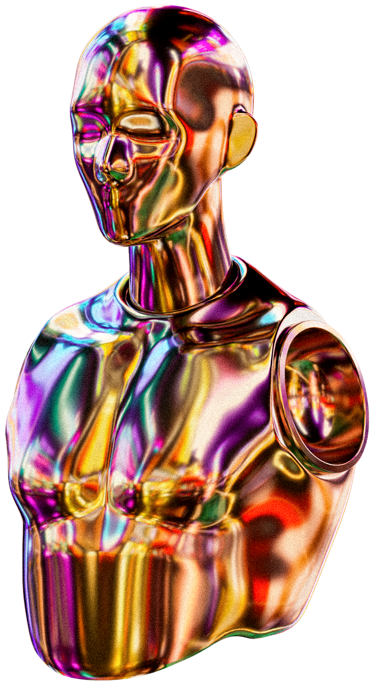

AI
PRESENTATION
PresentedBy: Bayrem Benkhoud

Slide 2
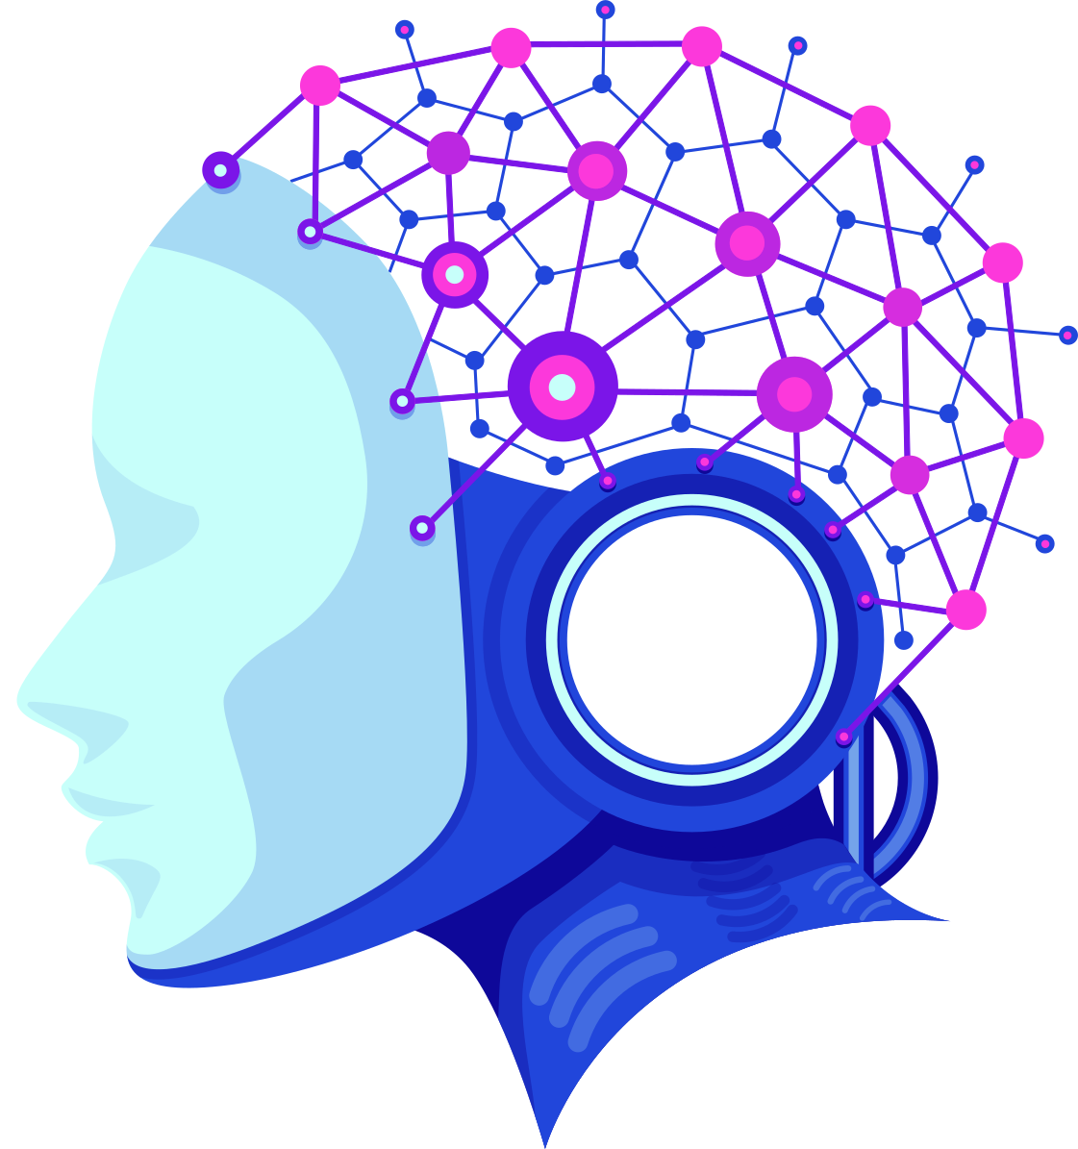

Data + AI = great
(and Important)

Slide 3

A relatable example, maybe something you saw online
So, you know how Netflix recommends shows you might like?
Think of data as all the info out there, and AI as the smart part that figures out what to do with it.

Slide 4



Basically, data science is like being a detective with numbers. You look at a bunch of data and try to find patterns and figure out what it all means. It uses math, computers, and knowing a bit about what you're looking at.

Slide 5
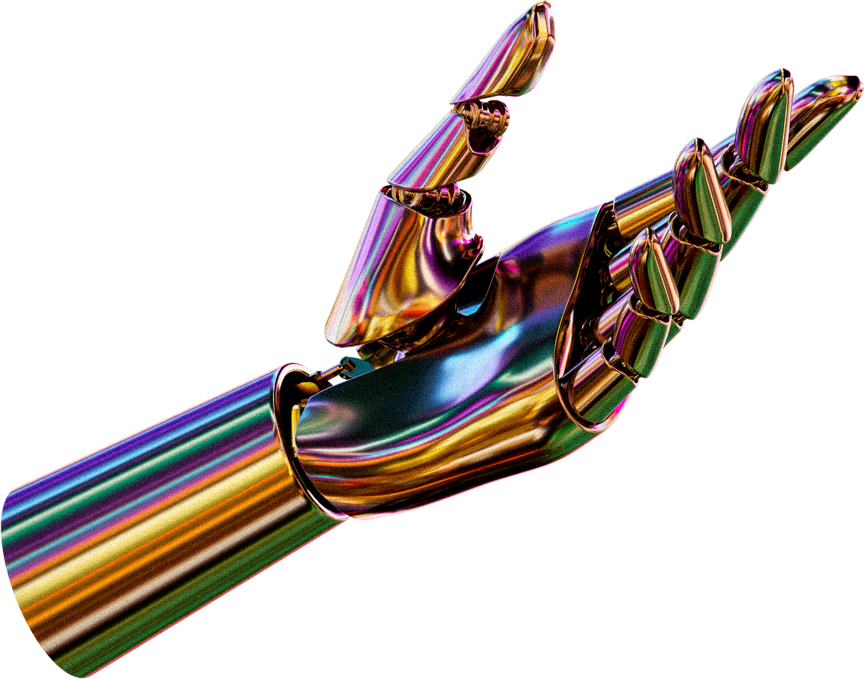
data & ai
work together through the following steps:
Data Collection
Data Preparation
Model Development
Deployment and Monitoring

Slide 6
The collaboration between data science and AI is indeed revolutionary,
driving innovation and enhancing capabilities across various sectors,
from healthcare to finance . As these fields continue to evolve,
their impact on society will only grow.
Conclusion

Slide 7
THANK YOU

